Slide 1
Timeline of The American Revolution
By
James Zaworski

Slide 2
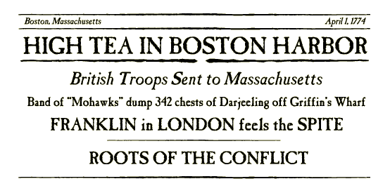

Slide 3
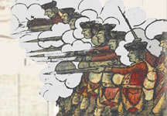
King George III ascends to the throne of England.
Treaty signed between England and France ending the French and Indian War. Canada and the continent east of the Mississippi River added to Great Britain's growing empire.
Parliament passes
The Stamp Act
to pay for British troops on the American frontier. Colonists violently protest the measure.
March 18. Stamp Act repealed, but on the same day parliament passes the Declaratory Act asserting its right to make laws binding on the colonies.
October. British troops arrive in Boston to enforce customs laws.

Slide 4
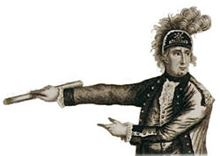
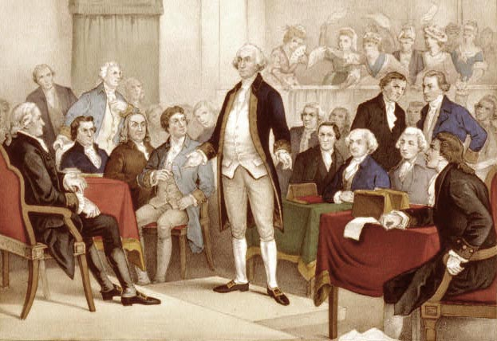
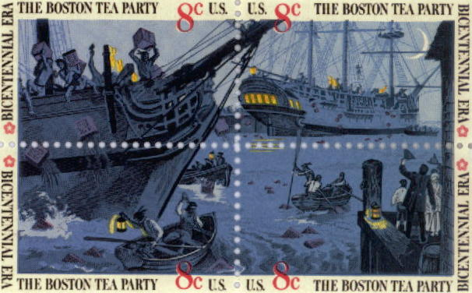
March. Four workers shot by British troops stationed in Boston. Patriots label the killings "The Boston Massacre."
December. Massachusetts patriots dressed as Mohawk Indians protest the British Tea Act by dumping crates of tea into the Boston Harbor.
First Continental Congress convenes in Philadelphia.
April. Shots fired at Lexington and Concord. "Minute Men" force British troops back to Boston. George Washington takes command of the Continental Army.

Slide 5
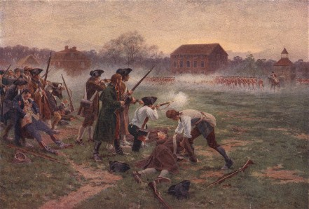
Battles of Lexington and Concord
First engagements of the Revolutionary War between British troops and the Minutemen, who had been warned of the attack by Paul Revere.

